Slide 1

Procured
An online test platform

Slide 2
Agenda
What is Procured?
Problem Statement
Why Procured?
Domain wise scenarios
Class Diagram
Admin Workbench
User Workbench
Technology Stack
What's next?

Slide 3

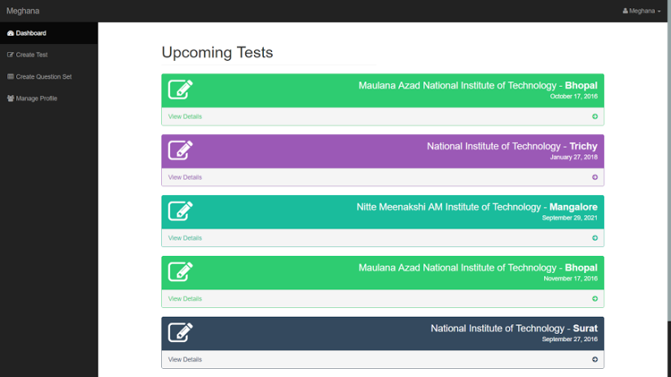
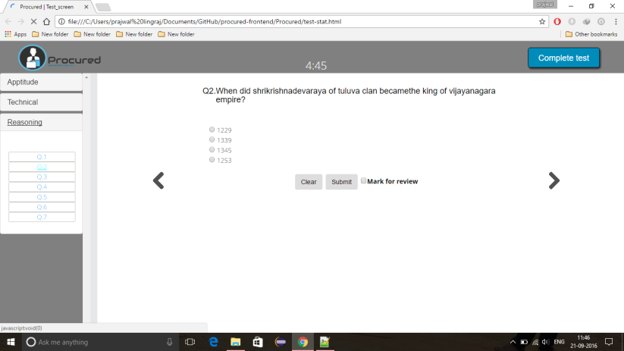
Online examination project is a web portal aiming at helping the employers to ease the campus recruitment process by conducting different examinations from this site for their hiring process while at the same time enhancing the experience of test takers and evaluators
On stop platform for all the preinterview processes
Reducing overheads faced by the HR
Initiate business requests and track progress

Slide 4
Problem Statement
“To ameliorate the campus recruitment process by digitising the platform thus enhancing the experience for both test taker and evaluator while at the same time decrease the cost per hire for the company.”
Current Challenges
Paper based manual examination which is time consuming and error prone.
Lack of genuineness and viability of the results.
Lack of clarity and information about the process.
Excessive overheads by the HR

Slide 5
Why Procured ?
Product and Platform
Create , schedule and conduct tests
Pre-asses for candidates
View results and real time analytics data

Slide 6
Domain-wise scenarios
HR
COLLEGE
CANDIDATE
Test
Store User Data
Pre-assessment
Create
Schedule
Assess Candidates
Placements
Question Bank
Reduce Overheads
Courses
View Results
Organized Process
Practice
Contact Colleges
Notice Board
Profile
User Management
Management Console
Security
Role Administration
Procured Framework
Authentication
Analytics
Application Management
Notifications
Offline Support

Slide 7
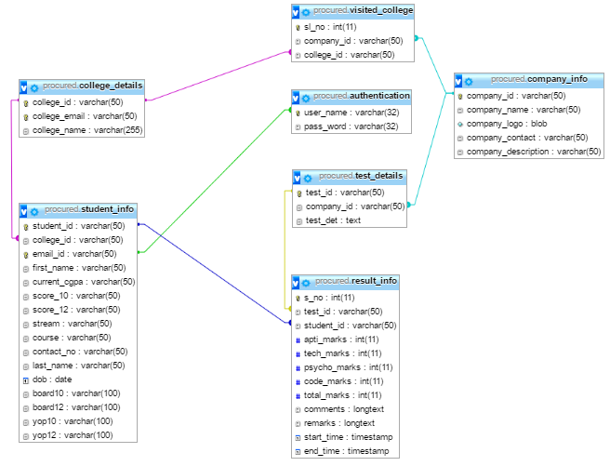
Database Diagram

Slide 8



Admin Workbench
The Admin workbench allows evaluators to control and monitor key aspects of the app and data source integration.
Data source management
Create and schedule tests
Upload question papers
Start and stop test
User management
Sorting based on scores
Real time access to user data with an option for comments
Collaborate with colleagues during interview process.
Test Reports
Sectional test results.
Analysis at forefront
Sorting based on shortlisting criteria.

Slide 9
User Workbench
The User workbench allows test takers to update their details, appear for the test and navigate among sections.
Update Details
Update personal details
Update Educational details
Reset Password
Take Test
Appear for the test by entering the Test ID provided by the HR or do a pre-asses.
Browse through various questions easily
Mark question for review if unsure
Feeds and feedback
Share your test experience on social media to increase your visibility
Give feedback to the system administrator and get a better experience at the next login.

Slide 10






Technology Stack
FRONTEND
BACKEND
SERVER
DATABASE

Slide 11

Future Scope
Automated surveillance
Social connect
Pre-asses for candidates
Pre-shortlisting for HR’s
Going Mobile
Analysis at forefront
Increased security

